Slide 1
CHAPTER 1:
Introduction

Slide 2
Why “Learn”?
Machine learning is programming computers to optimize a performance criterion using example data or past experience.
Learning is used when:
  Human expertise does not exist (navigating on Mars),
  Humans are unable to explain their expertise (speech recognition)
  Solution changes in time (routing on a computer network)
  Solution needs to be adapted to particular cases (user biometrics)

Slide 3
What We Talk About When We Talk About“Learning”
Learning general models from a data of particular examples
Data is cheap and abundant (data warehouses, data marts); knowledge is expensive and scarce.
Example in retail: Customer transactions to consumer behavior:
  People who bought “Da Vinci Code” also bought “The Five People You Meet in Heaven” (www.amazon.com)
Build a model that is a good and useful approximation to the data.

Slide 4
Data Mining/KDD
Definition := “KDD is the non-trivial process of
identifying valid, novel, potentially useful, and
ultimately understandable patterns in data” (Fayyad)
Applications:
Retail: Market basket analysis, Customer relationship management (CRM)
Finance: Credit scoring, fraud detection
Manufacturing: Optimization, troubleshooting
Medicine: Medical diagnosis
Telecommunications: Quality of service optimization
Bioinformatics: Motifs, alignment
Web mining: Search engines
...

Slide 5
What is Machine Learning?
Machine Learning
  Study of algorithms that
  improve their performance
  at some task
  with experience
Optimize a performance criterion using example data or past experience.
Role of Statistics: Inference from a sample
Role of Computer science: Efficient algorithms to
  Solve the optimization problem
  Representing and evaluating the model for inference

Slide 6
Growth of Machine Learning
Machine learning is preferred approach to
  Speech recognition, Natural language processing
  Computer vision
  Medical outcomes analysis
  Robot control
  Computational biology
This trend is accelerating
  Improved machine learning algorithms
  Improved data capture, networking, faster computers
  Software too complex to write by hand
  New sensors / IO devices
  Demand for self-customization to user, environment
  It turns out to be difficult to extract knowledge from human experts→failure of expert systems in the 1980’s.
Alpydin & Ch. Eick: ML Topic1

Slide 7
Applications
Association Analysis
Supervised Learning
  Classification
  Regression/Prediction
Unsupervised Learning
Reinforcement Learning

Slide 8

Learning Associations
Basket analysis:
P (Y | X ) probability that somebody who buys X also buys Y where X and Y are products/services.
Example: P ( chips | beer ) = 0.7
Market-Basket transactions

Slide 9
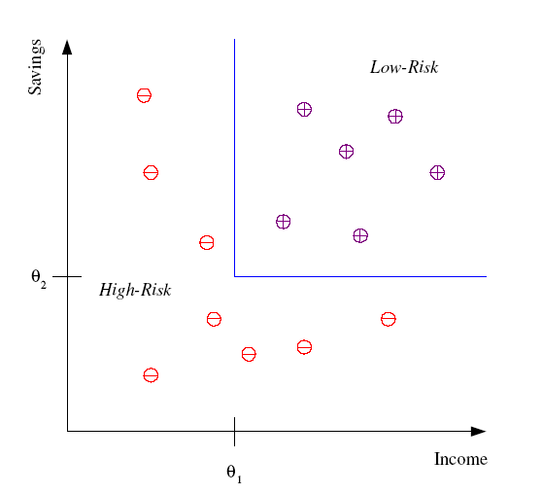
Classification
Example: Credit scoring
Differentiating between low-risk and high-risk customers from their income and savings
Discriminant: IF income > θ₁ AND savings > θ₂
THEN low-risk ELSE high-risk
Model

Slide 10
Classification: Applications
Aka Pattern recognition
Face recognition: Pose, lighting, occlusion (glasses, beard), make-up, hair style
Character recognition: Different handwriting styles.
Speech recognition: Temporal dependency.
  Use of a dictionary or the syntax of the language.
  Sensor fusion: Combine multiple modalities; eg, visual (lip image) and acoustic for speech
Medical diagnosis: From symptoms to illnesses
Web Advertizing: Predict if a user clicks on an ad on the Internet.

Slide 11








Face Recognition
Training examples of a person
Test images
AT&T Laboratories, Cambridge UK
http://www.uk.research.att.com/facedatabase.html

Slide 12
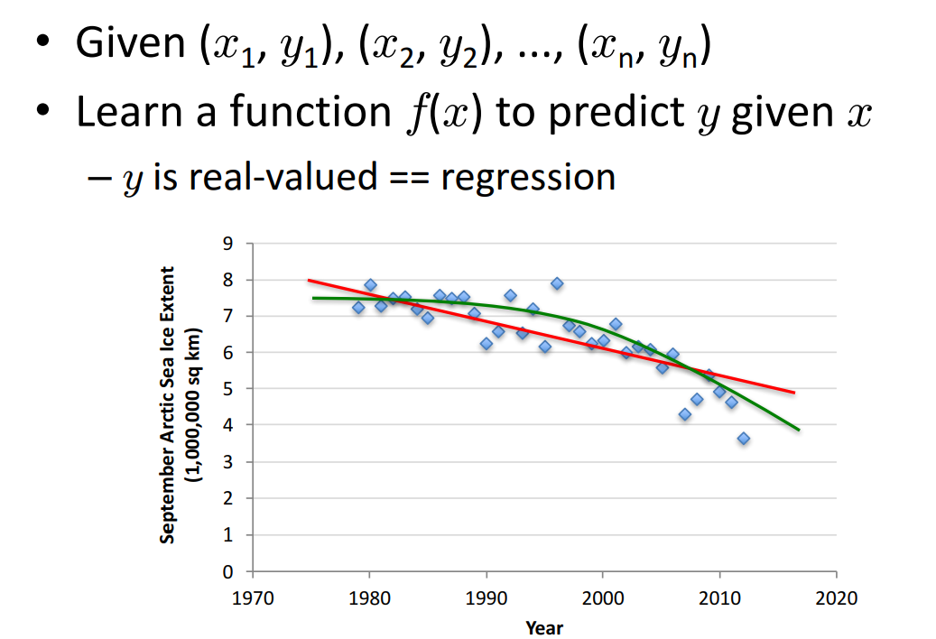
Regression

Slide 13
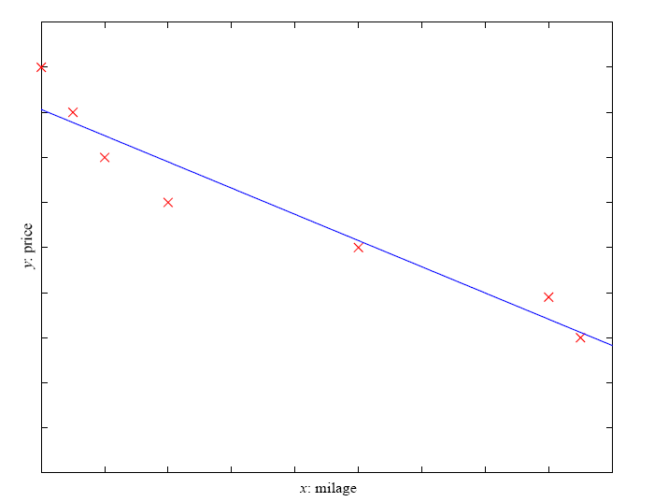
Prediction: Regression
Example: Price of a used car
x : car attributes
y : price
y = g (x | θ )
g ( ) model,
θ parameters
y = wx+w₀

Slide 14
Regression Applications
Navigating a car: Angle of the steering wheel (CMU NavLab)
Kinematics of a robot arm
(x,y)
α₁= g₁(x,y)
α₂= g₂(x,y)
α₂
α₁

Slide 15
Supervised Learning: Uses
Example: decision trees tools that create rules
Prediction of future cases: Use the rule to predict the output for future inputs
Knowledge extraction: The rule is easy to understand
Compression: The rule is simpler than the data it explains
Outlier detection: Exceptions that are not covered by the rule, e.g., fraud

Slide 16
Unsupervised Learning
Learning “what normally happens”
No output
Clustering: Grouping similar instances
Other applications: Summarization, Association Analysis
Example applications
  Customer segmentation in CRM
  Image compression: Color quantization
  Bioinformatics: Learning motifs

Slide 17
Unsupervised Learning
A good unsupervised learning algorithm should be able to
figure out some criteria to group similar inputs together using only the
information of all possible inputs, where two inputs are said to be similar
only when they are expected to yield the same output label.
The fundamental difficulty in unsupervised learning lies in how to know which
inputs are similar when their output labels are unavailable. Unsupervised
learning is a much harder problem because of the lack of supervision information.
In unsupervised learning, it is usually cheaper to collect training
data because it does not require extra human efforts to label each input
with the corresponding output. However, unsupervised learning largely
remains an open problem in machine learning.
Alpydin & Ch. Eick: ML Topic1

Slide 18
Reinforcement Learning
Topics:
  Policies: what actions should an agent take in a particular situation
  Utility estimation: how good is a state (→used by policy)
No supervised output but delayed reward
Credit assignment problem (what was responsible for the outcome)
Applications:
  Game playing
  Robot in a maze
  Multiple agents, partial observability, ...

Slide 19
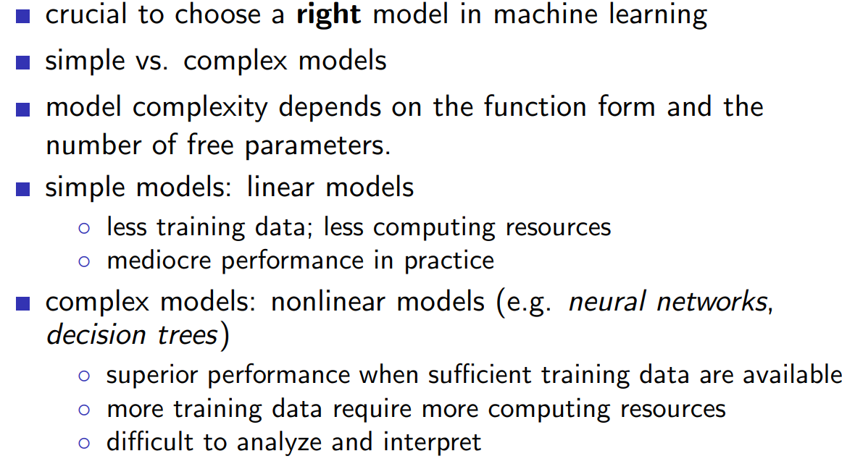
Simple vs. Complex Models
Alpydin & Ch. Eick: ML Topic1

Slide 20
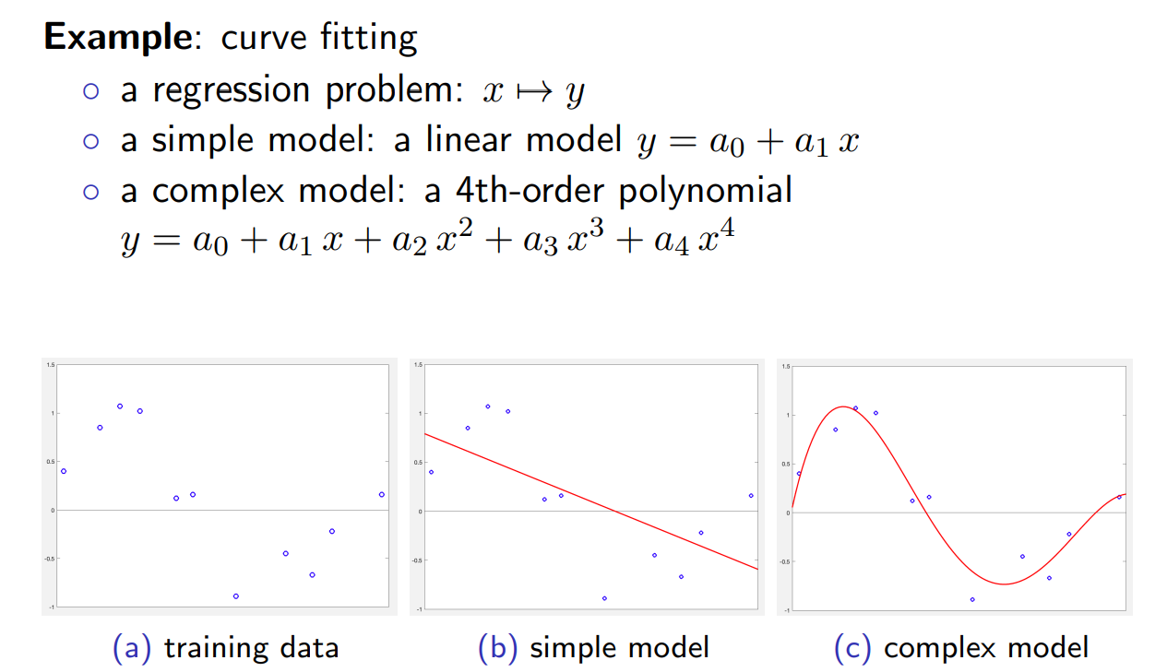
Simple vs. Complex Models
Alpydin & Ch. Eick: ML Topic1

Slide 21
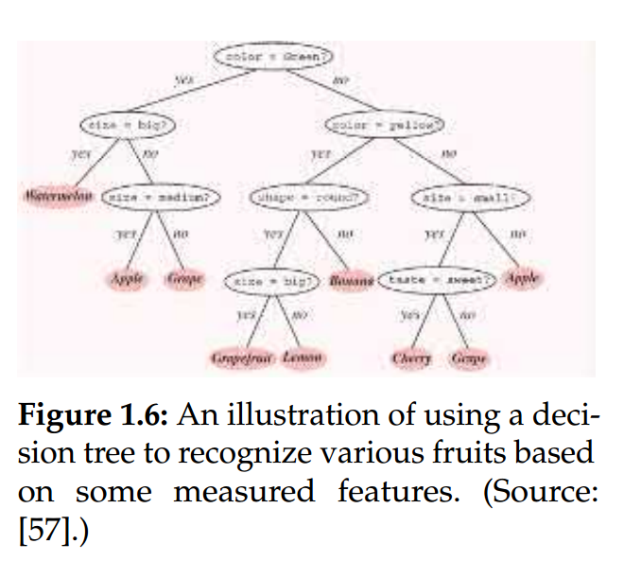
Decision tree
Assume we want to teach a computer to recognize different fruits based on some observed characteristics, such as size, color, shape, and taste.
Consider a suitable model that can be used for this purpose.
In this model, each internal node is associated with a binary question regarding one aspect of the characteristics, and each leaf node corresponds to one class of fruits.
This process is repeated until a leaf node is reached. The class label of the reached leaf node is the
classification result for the unknown object.

Slide 22
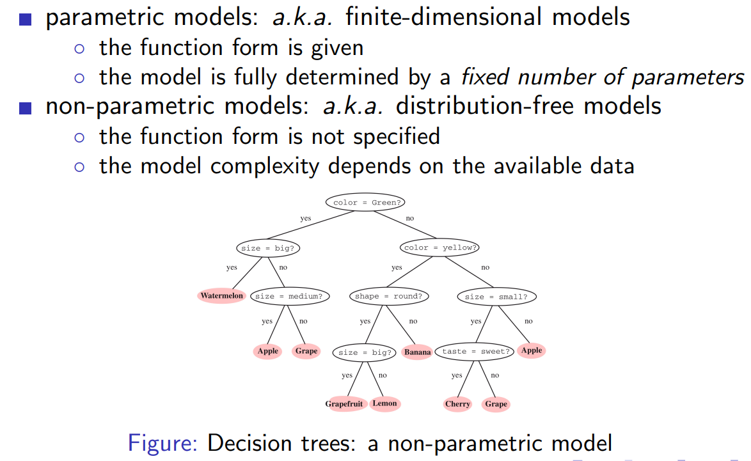
Parametric versus Nonparametric Models

Slide 23
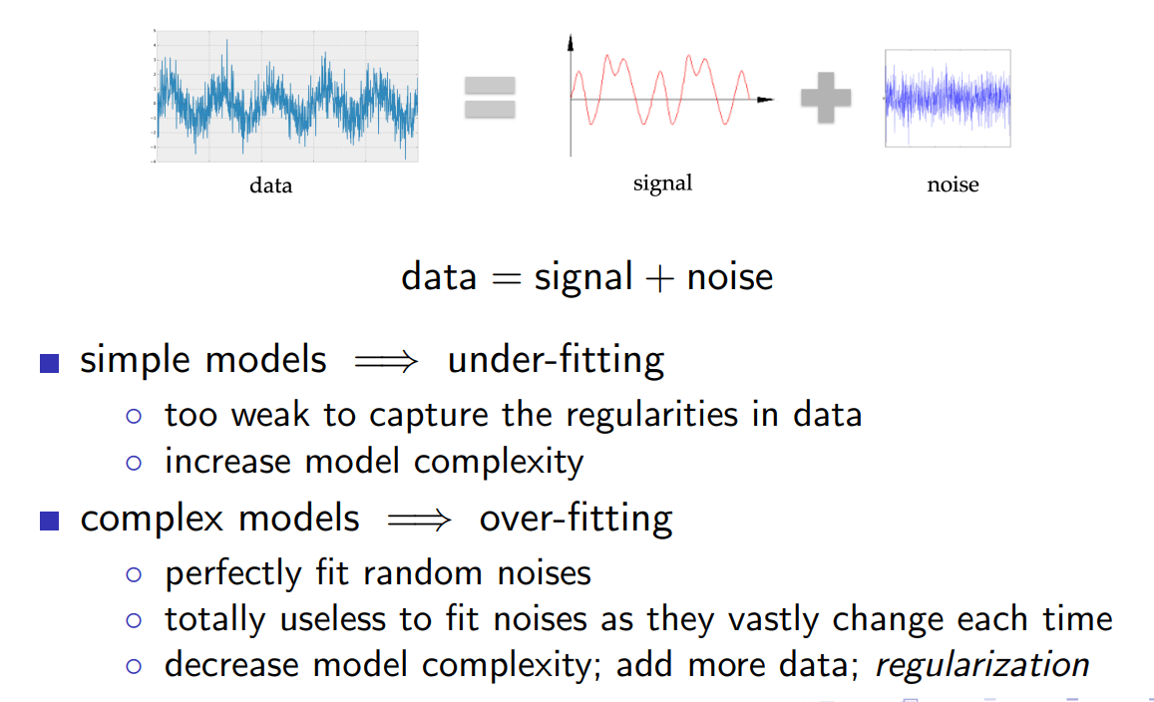
Over-fitting vs. Under-fitting
Alpydin & Ch. Eick: ML Topic1

Slide 24
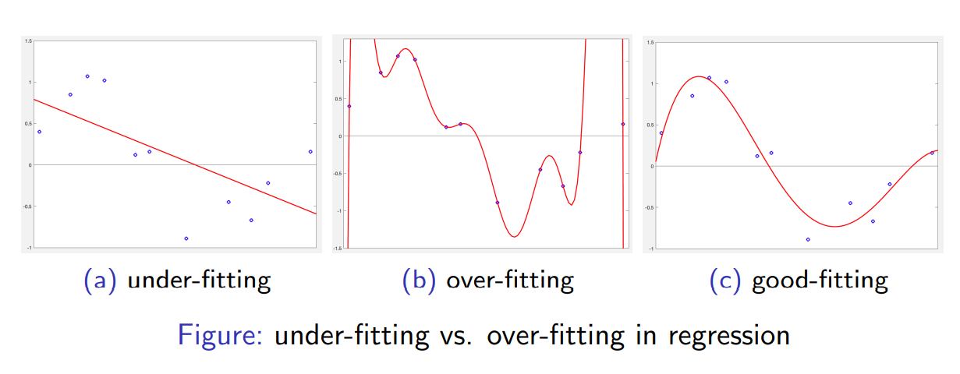
Over-fitting vs. Under-fitting
Alpydin & Ch. Eick: ML Topic1

Slide 25
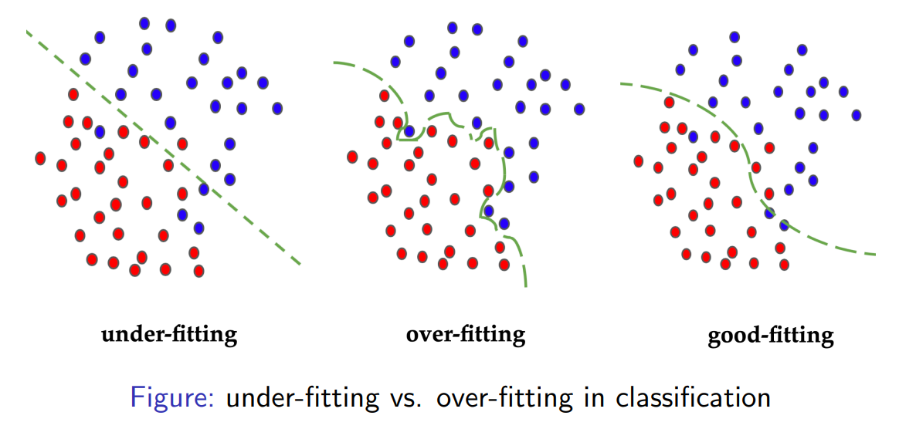
Over-fitting vs. Under-fitting
Alpydin & Ch. Eick: ML Topic1

Slide 26
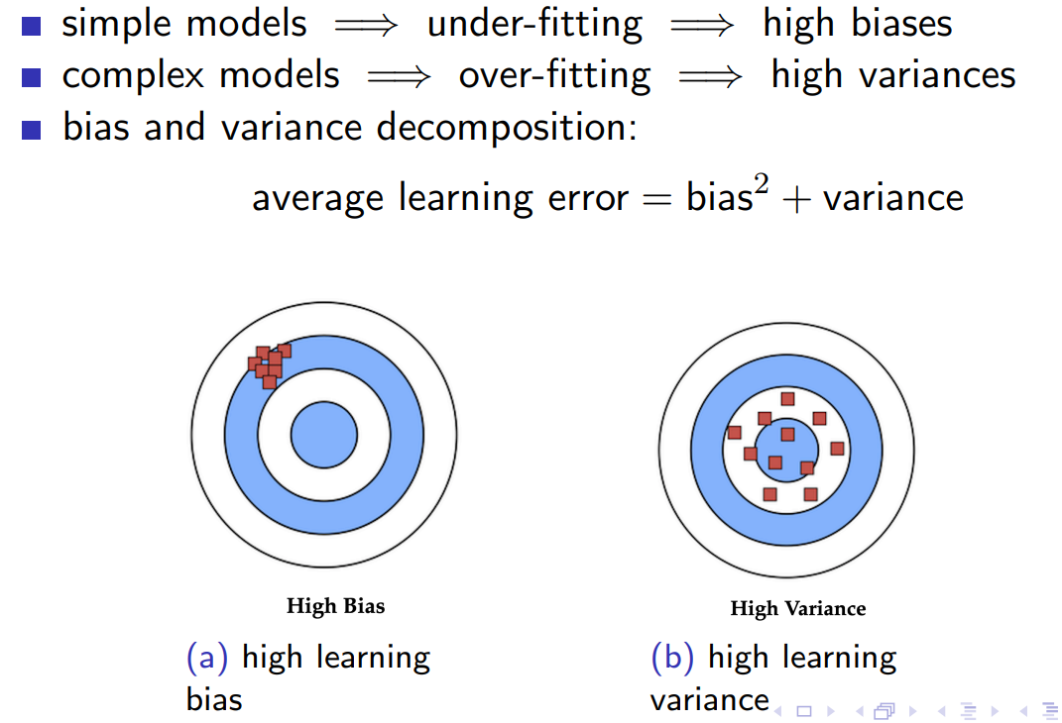
Bias-Variance Tradeof
Alpydin & Ch. Eick: ML Topic1

Slide 27
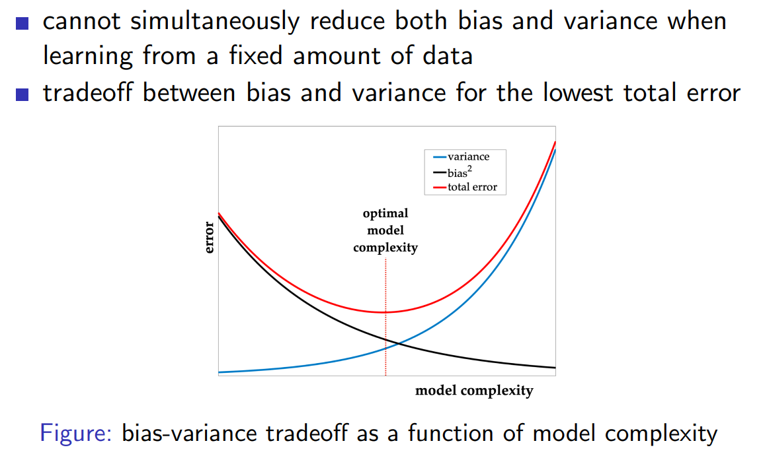
Bias-Variance Tradeof
Alpydin & Ch. Eick: ML Topic1

Slide 28
Resources: Datasets
UCI Repository: http://www.ics.uci.edu/~mlearn/MLRepository.html
UCI KDD Archive: http://kdd.ics.uci.edu/summary.data.application.html
Statlib: http://lib.stat.cmu.edu/
Delve: http://www.cs.utoronto.ca/~delve/

Slide 29
Resources: Journals
Journal of Machine Learning Research www.jmlr.org
Machine Learning
IEEE Transactions on Neural Networks
IEEE Transactions on Pattern Analysis and Machine Intelligence
Annals of Statistics
Journal of the American Statistical Association
...

Slide 30
Resources: Conferences
International Conference on Machine Learning (ICML)
European Conference on Machine Learning (ECML)
Neural Information Processing Systems (NIPS)
Computational Learning
International Joint Conference on Artificial Intelligence (IJCAI)
ACM SIGKDD Conference on Knowledge Discovery and Data Mining (KDD)
IEEE Int. Conf. on Data Mining (ICDM)

